Slide 1
<DATA STRUCTURES AND ALGORITHM>

Slide 2
Ii. RECURSION AND BACKTRACKING

Slide 3
RECURSION
Any function which calls itself is called recursive. A recursive method solves a problem by calling a copy of itself to work on a smaller problem. This is called the recursion step. The recursion step can result in many more such recursive calls.

Slide 4
Mathematical interpretation
Let us consider a problem that a programmer have to determine the sum of first n natural numbers. There are several ways but the simple one is recursive adding. Suppose n = 100.
approach(1): Simply adding one by one
f(n) = 1 + 2 + 3 +……..+ 100
approach(2) – Recursive adding
f(n) = n + f(n-1) n>1

Slide 5
It is important to ensure that the recursion terminates. Each time the function calls itself with a slightly simpler version of the original problem. The sequence of smaller problems must eventually converge on the base case.
Base case: When the function completes without making a recursive call
Recursive case: Where the function calls itself to perform a subtask

Slide 6
PROPERTIES
A recursive function can go infinite like a loop. To avoid infinite running of recursive function, there are two properties that a recursive function must have:
Base criteria − There must be at least one base criteria or condition, such that, when this condition is met the function stops calling itself recursively.
Progressive approach − The recursive calls should progress in such a way that each time a recursive call is made it comes closer to the base criteria.

Slide 7
DIRECT AND INDIRECT RECURSION
A function fun is called direct recursive if it calls the same function fun.
A function fun is called indirect recursive if it calls another function say fun_new and fun_new calls fun directly or indirectly.

Slide 8
// An example of direct recursion
void directRecFun()
{
// Some code....
directRecFun();
// Some code...
}

Slide 9
// An example of indirect recursion
void indirectRecFun1()
{
// Some code...
indirectRecFun2();
// Some code...
}
void indirectRecFun2()
{
// Some code...
indirectRecFun1();
// Some code...
}

Slide 10
WHY RECURSION?
Recursion is a useful technique borrowed from mathematics. Recursive code is generally shorter and easier to write than iterative code. Generally, loops are turned into recursive functions when they are compiled or interpreted.
Recursion is most useful for tasks that can be defined in terms of similar subtasks. For example, sort, search, and traversal problems often have simple recursive solutions.

Slide 11
EXAMPLE OF RECURSION
FIBONACCI SERIES

Slide 12
EXERCISE OF RECURSION
IMPLEMENT FACTORIAL WITH RECURSION

Slide 13
EXERCISE OF RECURSION
int exercise1(int x, int y)
{
if (x == 0)
return y;
else
return exercise1(x - 3, y + x + 1);
}

Slide 14
EXERCISE OF RECURSION
void exercise2(int n)
{
int i = 0;
if (n > 1)
exercise2(n-1);
for (i = 0; i < n; i++)
printf(" * ");
}

Slide 15
RECURSION AND MEMORY
Each recursive call makes a new copy of that method (actually only the variables) in memory. Once a method ends (that is, returns some data), the copy of that returning method is removed from memory.

Slide 16
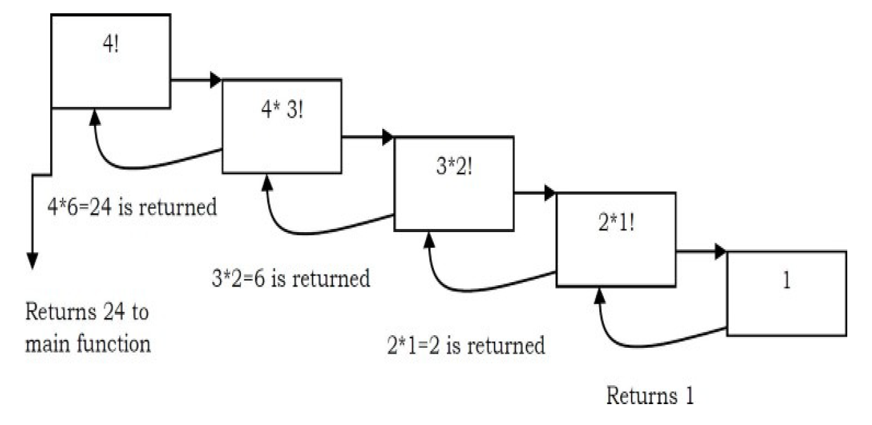
RECURSION AND MEMORY
The visualization of factorial function with n=4 will look like:

Slide 17
BACKTRACKING
Backtracking is an improvement of the brute force approach. It systematically searches for a solution to a problem among all available options.
In backtracking, we start with one possible option out of many available options and try to solve the problem if we are able to solve the problem with the selected move then we will print the solution else we will backtrack and select some other option and try to solve it.
If none if the options work out we will claim that there is no solution for the problem.

Slide 18
BACKTRACKING
Backtracking allows us to deal with situations in which a raw brute-force approach would explode into an impossible number of options to consider.
Backtracking is a sort of refined brute force. At each node, we eliminate choices that are obviously not possible and proceed to recursively check only those that have potential.

Slide 19
Example Algorithms of Backtracking
SUDOKU
N-Queens Problem
The Knapsack Problem

Slide 20
REFERENCES
Data Structures And Algorithms Made Easy: Data Structures And Algorithmic Puzzles by Narasimha Karumanchi
https://www.geeksforgeeks.org/
https://www.tutorialspoint.com

